Slide 1
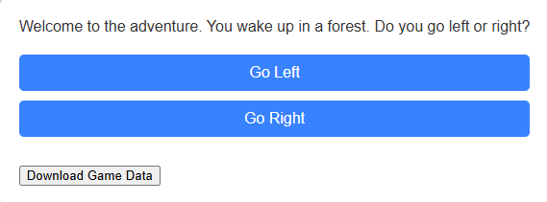
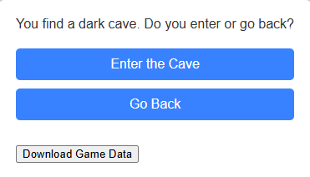
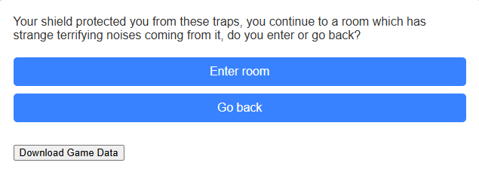
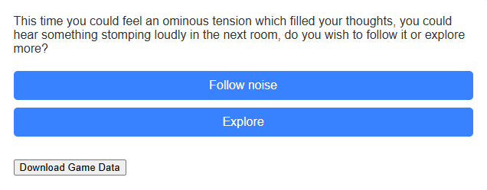
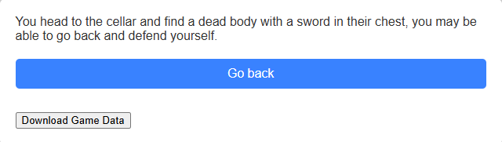


My Adventure Game
The Fantasy adventure game
This is my progress-based adventure game!
Fight your way through the unknown!
Use trial and error to your advantage!
Track your progress!
Become a hero!
Luke Sampson
BSc(hons) Computer Science (Games development) 2025
Luke.sampson@students.Plymouth.ac.uk

